Slide 1

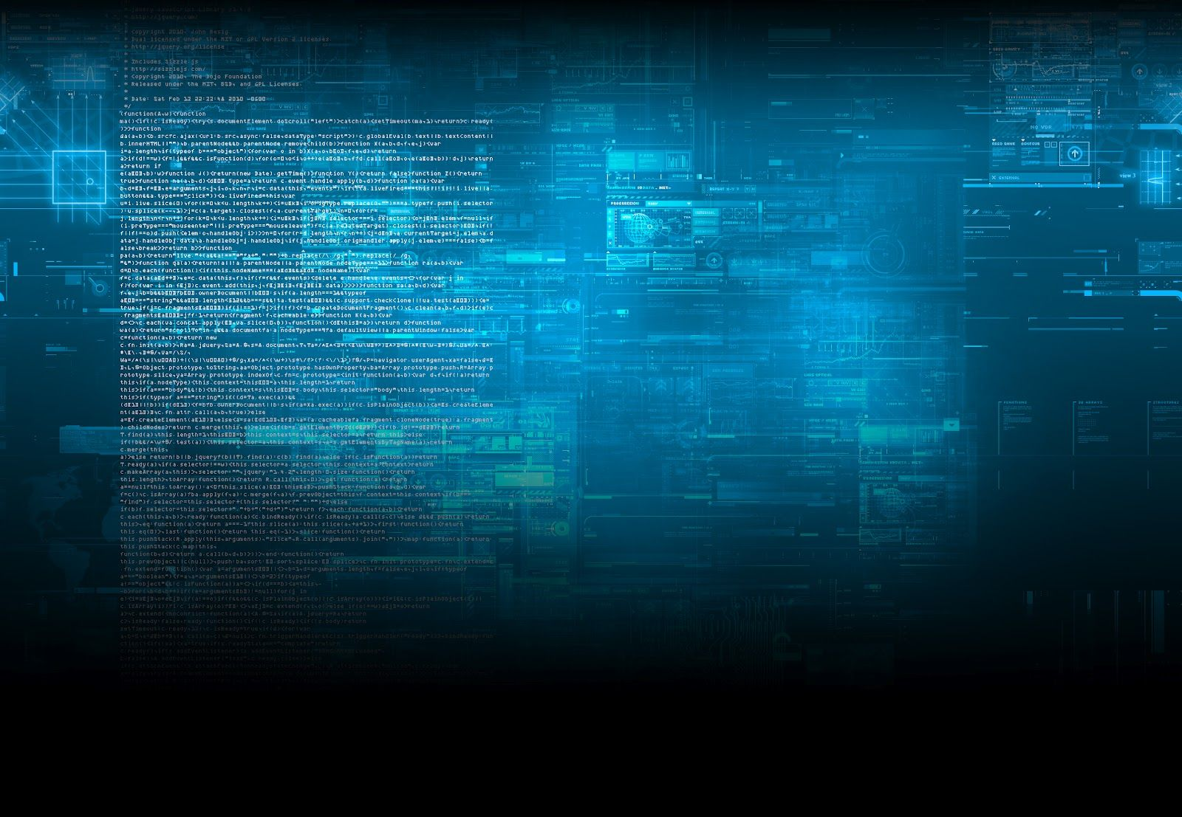
QSKT 101
Intro to Quantum Computing
Notes:
Good morning, everyone! How many of you have heard of quantum computing? Maybe in a movie, a news article, or a tech podcast? [Pause for show of hands]. Great. Today, in the next 30 minutes, we're going to move beyond the buzzwords and build a foundational understanding of what it actually is and why it's so exciting.

Slide 2
Domain of Classical Computers
Our world runs on classical computers. Laptops, phones, the cloud, almost all devices we use and wear are classical computers tuned to specialize in certain functions.
Classical computers use 0s and 1s in various patterns to represent data. Yes or no. On or off.
There is NO alternative besides the 0s and 1s – only different permutations of them. This makes certain problems very hard to approach using only classical bits.
Notes:
Our world runs on classical computers. Your phone, your laptop, the cloud—they all think in bits. A bit is a 1 or a 0. On or off. Yes or no. It's the only language they speak.
This is great for most tasks: sending emails, watching videos, writing documents. But for certain, incredibly complex problems, even the most powerful supercomputers in the world hit a wall.

Slide 3

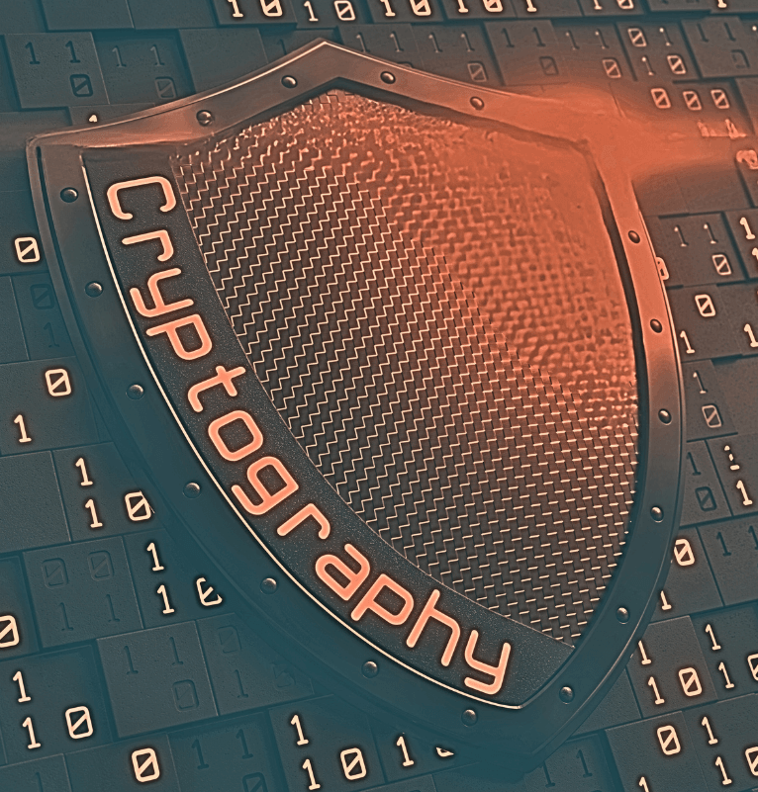
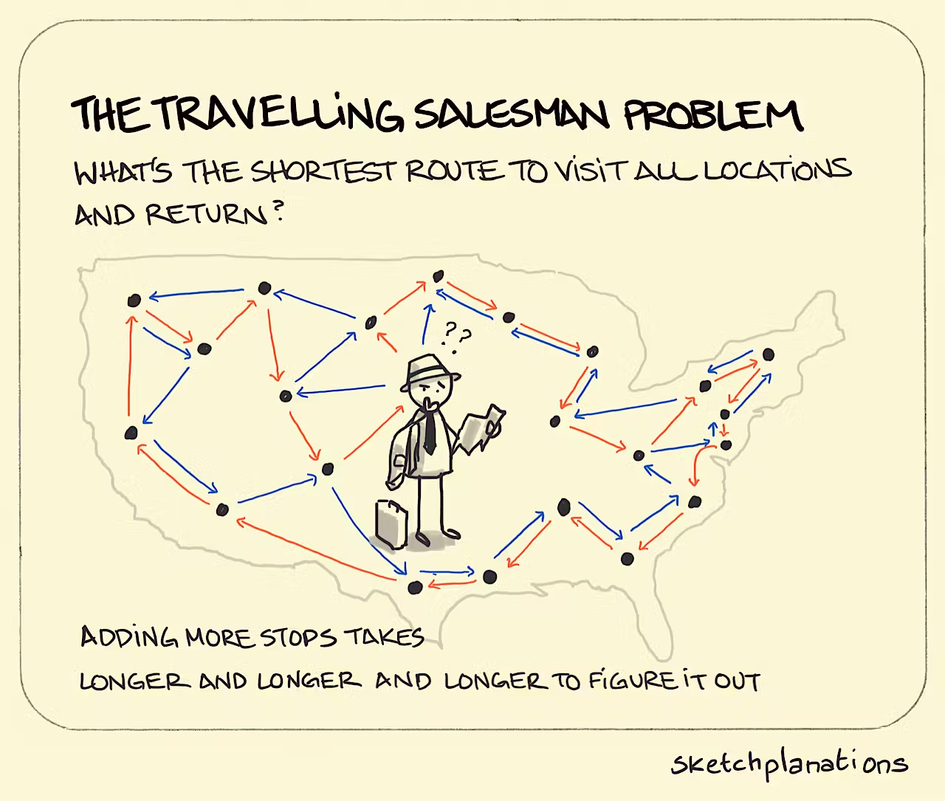
Problems we can’t solve (easily)
Notes:
Drug Discovery: Simulating a single molecule precisely. (Atoms interact in ways that are too complex for classical bits to model efficiently).
Optimization: Finding the absolute best route for a global shipping network (The "Traveling Salesperson Problem" on a massive scale).
Cryptography: Most of our online security is based on the fact that it would take a classical computer thousands of years to break it.
So, we need a new tool for a new class of problems. And that tool might be the quantum computer.

Slide 4

Meet the Qubit
A qubit (Quantum bit) is like a coin spinning in the air. It’s neither heads nor tails, neither yes nor no, but rather represents both while in the air.
I have done nothing but hover between 0 and 1 for the last 3 days.
Qubits exist in a probabilistic distribution of landing on 0 or 1 until they are measured. This ability to be in a mix of states is known as Superposition.
Notes:
The quantum equivalent of a bit is called a qubit (quantum bit). But a qubit is far more powerful.
Let's use this coin. A classical bit is like a coin that has already landed. It's either Heads (1) or Tails (0). That's it.
A qubit is like a coin while it's spinning in the air. Is it heads? Is it tails? It's not either—it's both, simultaneously, with some probability of being one or the other when it lands. This ability to be in a mix of states is called Superposition.

Slide 5
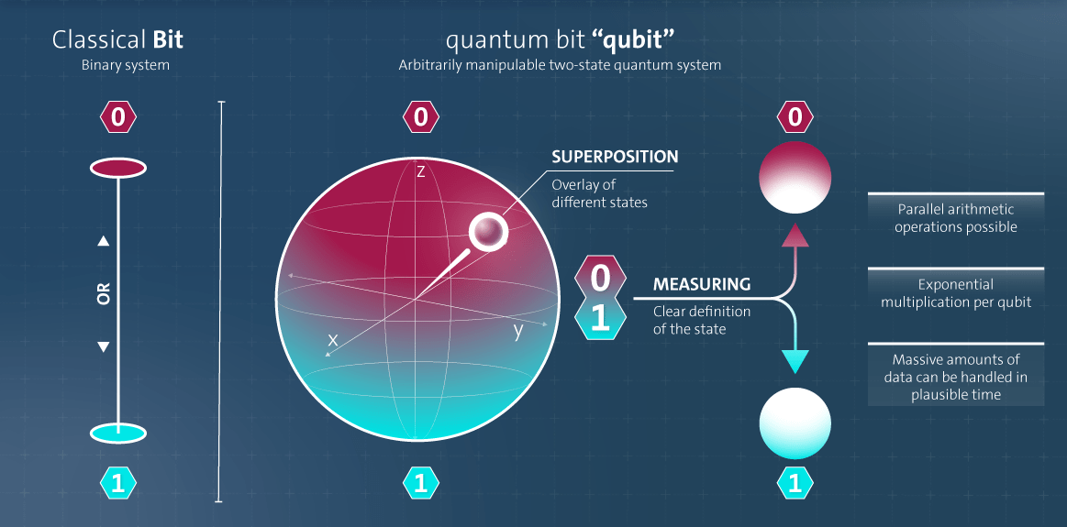
Notes:
So, a qubit isn't just 1 or 0. It's a probability distribution. It can be 70% likely to be 1 and 30% likely to be 0, or any other combination. This is our first key insight: A qubit can represent multiple states at once.

Slide 6
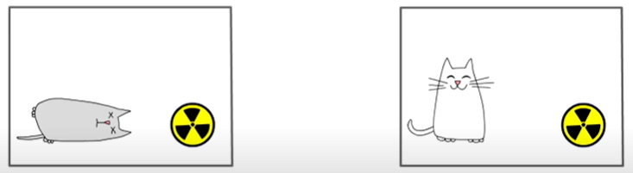
Qubits in Entanglement
Besides superposition, qubits can also exist in a state of Entanglement, where, the measurement of one qubit can determine the value of the other regardless of the distance between them.
Imagine two instances of Schrodinger’s cat experiment, except, the fate of one cat immediately confirms the fate of the other without us needing to check it.
Notes:
Now, let's make it weirder. Imagine I have two entangled coins. I flip them. If I look at one and it's heads, I instantly know the other one is tails, no matter how far apart they are.
This is Entanglement: a deep connection between qubits where the state of one directly influences the state of another. This allows qubits to be deeply correlated in ways classical bits can't, supercharging their computational power.

Slide 7
Notes:
Here's the catch: the moment you measure a qubit, the magic disappears. The superposition collapses into a definite state: a definitive 1 or a 0. You get a single, classical answer. The art of quantum algorithms is to set up the probabilities through calculations so that when this collapse happens, the answer you get is almost certainly the correct answer to your problem.

Slide 8
Activity time - Coding with Qiskit
Go to this github repository:
github.com/Visnu-Pandian/QSKT-101-Intro-to-Quantum-Computing
and clone the main branch to your local system. Download the required libraries if you haven’t already via your terminal:
pip install -r requirements.txt
This guide uses Python 3.13.2, but other versions may also work.
Once you are ready, open qc_cointoss.py!
CyberWVU

Slide 9
Challenge time - Biased coins
Open qc_challenge.py. Tests are located in qc_unit_test.py
YOUR TASK: Create a circuit that resets any single-qubit state to |0>.
Available gates:
qc.x(0) # Pauli-X gate (bit flip)
qc.h(0) # Hadamard gate (creates superposition)
qc.id(0) # Identity gate (does nothing)
Available conditional statements:
with qc …
qc.if_test((...))
CyberWVU

Slide 10
So… where are they?
Quantum Computers are not like our portable laptops and mobile phones. They are enormous systems that require near absolute zero (-460° F) to minimize noise when working with qubits. Keeping qubits stable long enough to do useful work with them is the central problem of QC today.
Current goals:
Minimize noise interference
Improve error correction algorithms
Harness “Quantum-advantage” : Definitively solve problems which are known to be unsolvable or unfeasible using classical computers
Notes:
The biggest challenge is decoherence, or noise. Remember our spinning coin? Any tiny vibration, any bit of heat, is like bumping the table—it causes the coin to fall early, ruining the calculation. Keeping qubits stable long enough to do useful work is the central engineering problem. We're in the era of NISQ (Noisy Intermediate-Scale Quantum) devices—powerful but error-prone.

Slide 11
What can we expect?
Questions?
Quantum computing is a highly specialized tool which opens avenues towards tackling the universe’s most complex problems such as creating new materials and harnessing space-time. It’s not a new technology, just a new way of thinking about information.
Notes:
Quantum computing isn't about replacing your laptop. It's a specialized tool for tackling the universe's most complex problems, from designing new materials to unlocking the secrets of nature itself.

